Slide 1
First in First Out
Linear

Slide 2
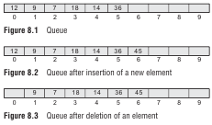
Array representation of queue

Slide 3
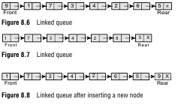
Linked representation of queue

Slide 4
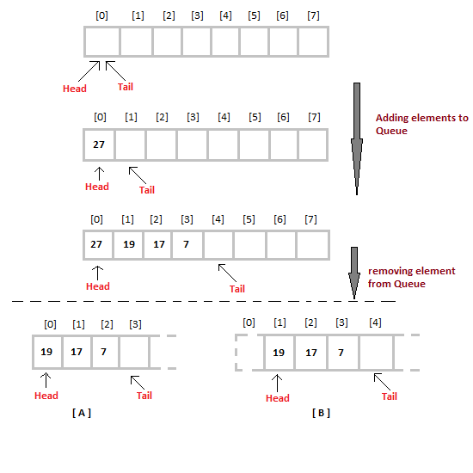
Operations on Queue
Insertion/Enqueue
Deletion/Dequeue

Slide 5
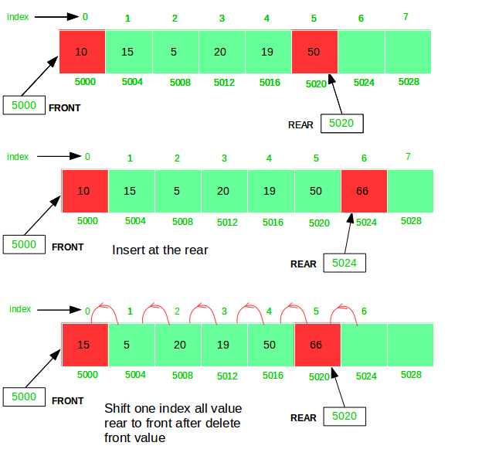
Queue insertion/enqueue

Slide 6
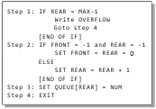
Queue insertion

Slide 7
Insert into linked Queue

Slide 8
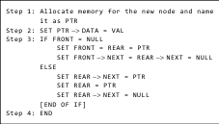
Insert into linked Queue

Slide 9
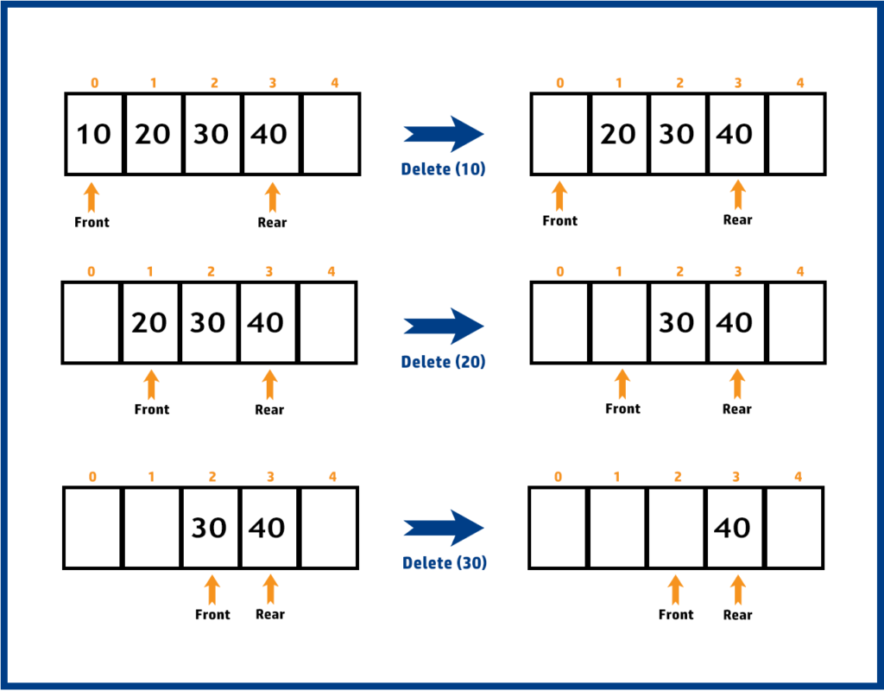
Queue Deletion/Dequeue

Slide 10
Queue Deletion

Slide 11
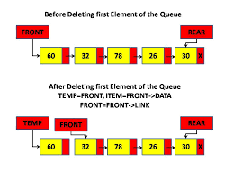
Delete from linked Queue

Slide 12
Delete from Linked queue

